Slide 1
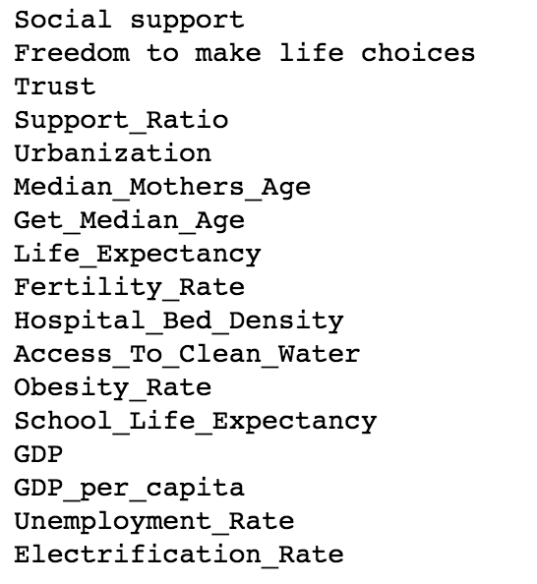
World Happiness
On a scale between one and ten, where ten is your best possible life, and zero is your worst possible life, how would you rate your current life satisfaction?
Features

Slide 2
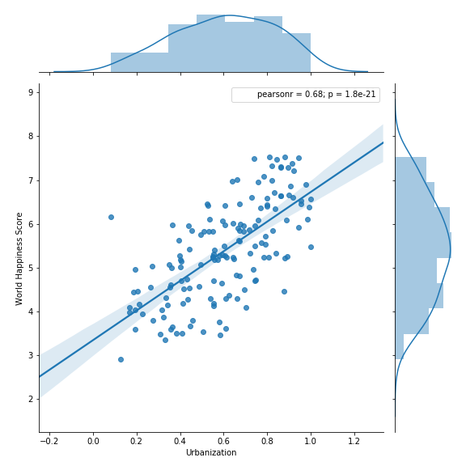
World Happiness and Urbanization
Urbanization Coefficient: 3.4
Urbanization is between 0 and 1
World Happiness is between 0 and 10

